Slide 1
Employee management System
Presented By:
Hafiz Muhammad Zaman Khan(Fa21-Bse-063-B)
And Ammar Ahmed(Fa21-Bse-059-B)

Slide 2
Project Introduction
In this Project we have created an Employee Management System to handle all the necessary records of Employees .

Slide 3
Cause and Reason
Managing records of hundreds of employee can be a great hustle without a proper management system so we have created an Employee management system gives the opportunity to handle all the records through a valid authority i.e. Administrator .
Where as Employees only have the authority to view their own record.

Slide 4
Topics we covered in our project
File Handling
Structures
Iterations (Loop)
Switch
Functions
Strings
Goto (Because we need this function).
Pointers

Slide 5
Number and Names of Modules
Administrator
Add employee record
List employees record
Modify or update employees record
Delete employees record
Go to main menu
Employee details (Access by using their username and password)
Exit(Exit from management system)

Slide 6
Administration Portal
Add employee record
This sub-module lets the admin to add one or more than one employees record.
List employees record
This sub-module helps the admin to see existing employees records.
Modify or update employees record
This sub-module helps the admin to modify or update a particular field of a selected employee record.
Delete employees record
This sub-module helps the admin to delete one or more than one record by just using their username.
Go to main menu
Lets the admin to return to main menu instead of breaking the program.

Slide 7
Exit
Employee detail
It only allows the employee/user to view their own record by using their registered credentials.
Using this module the user can easily or safely exit the program

Slide 8
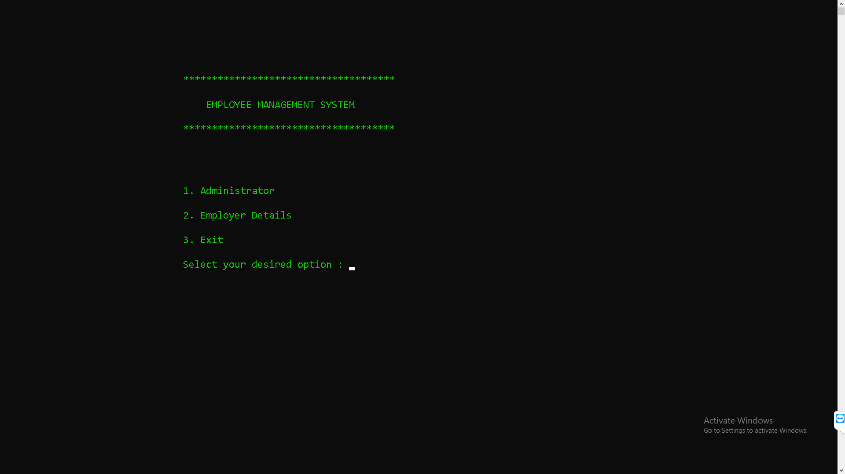
Employee Management system

Slide 9
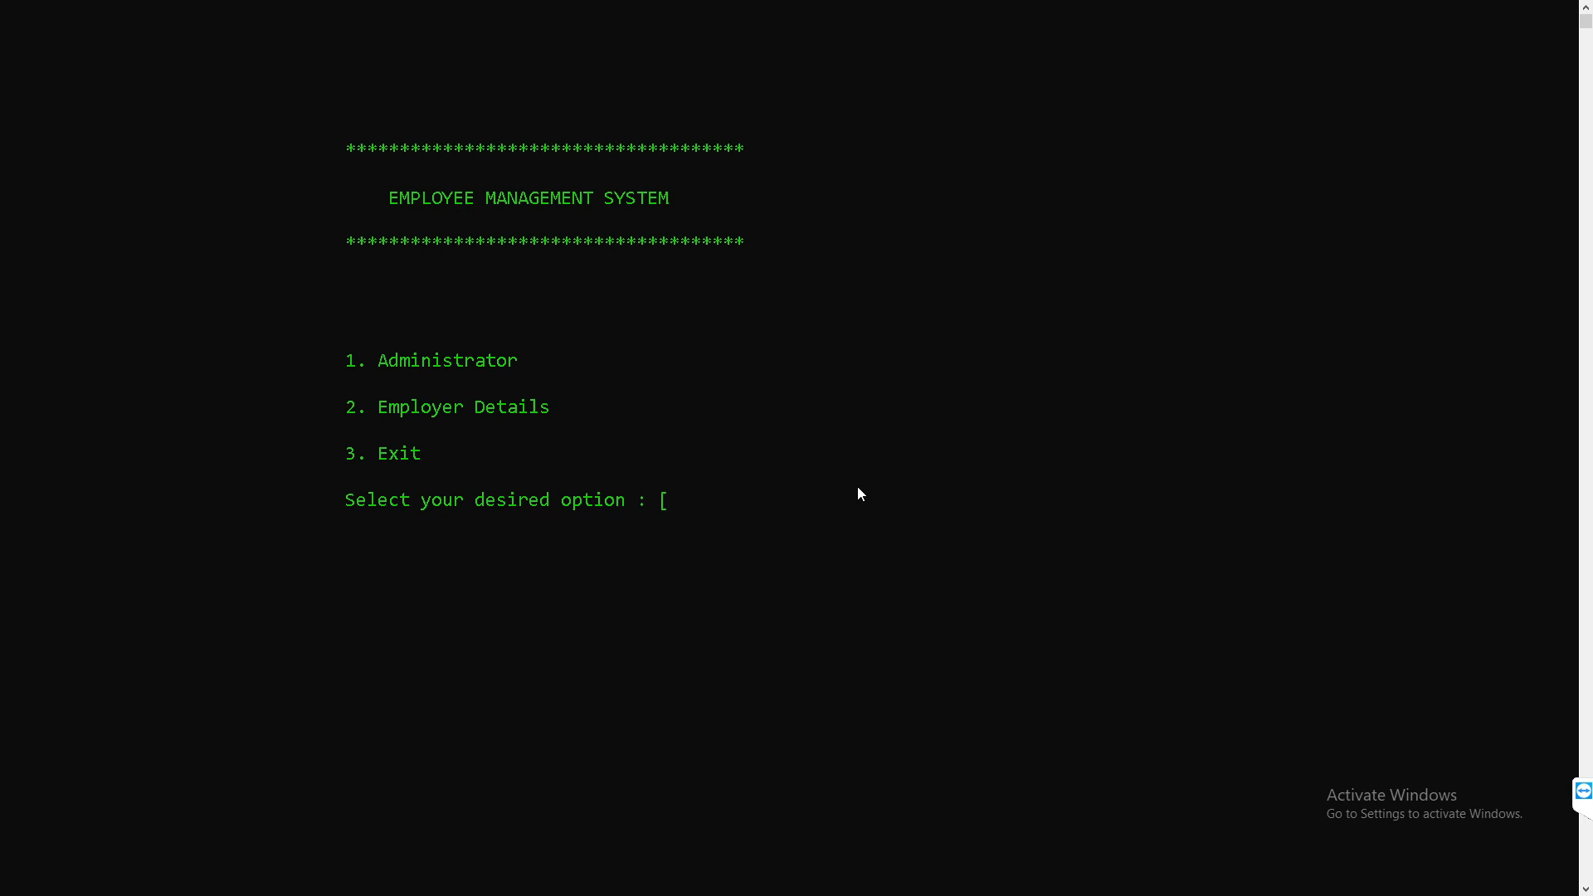
Administration Portal

Slide 10
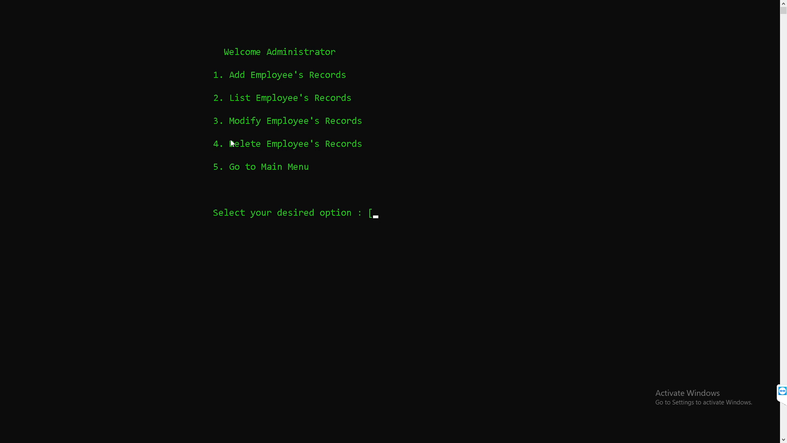
Add employees record

Slide 11
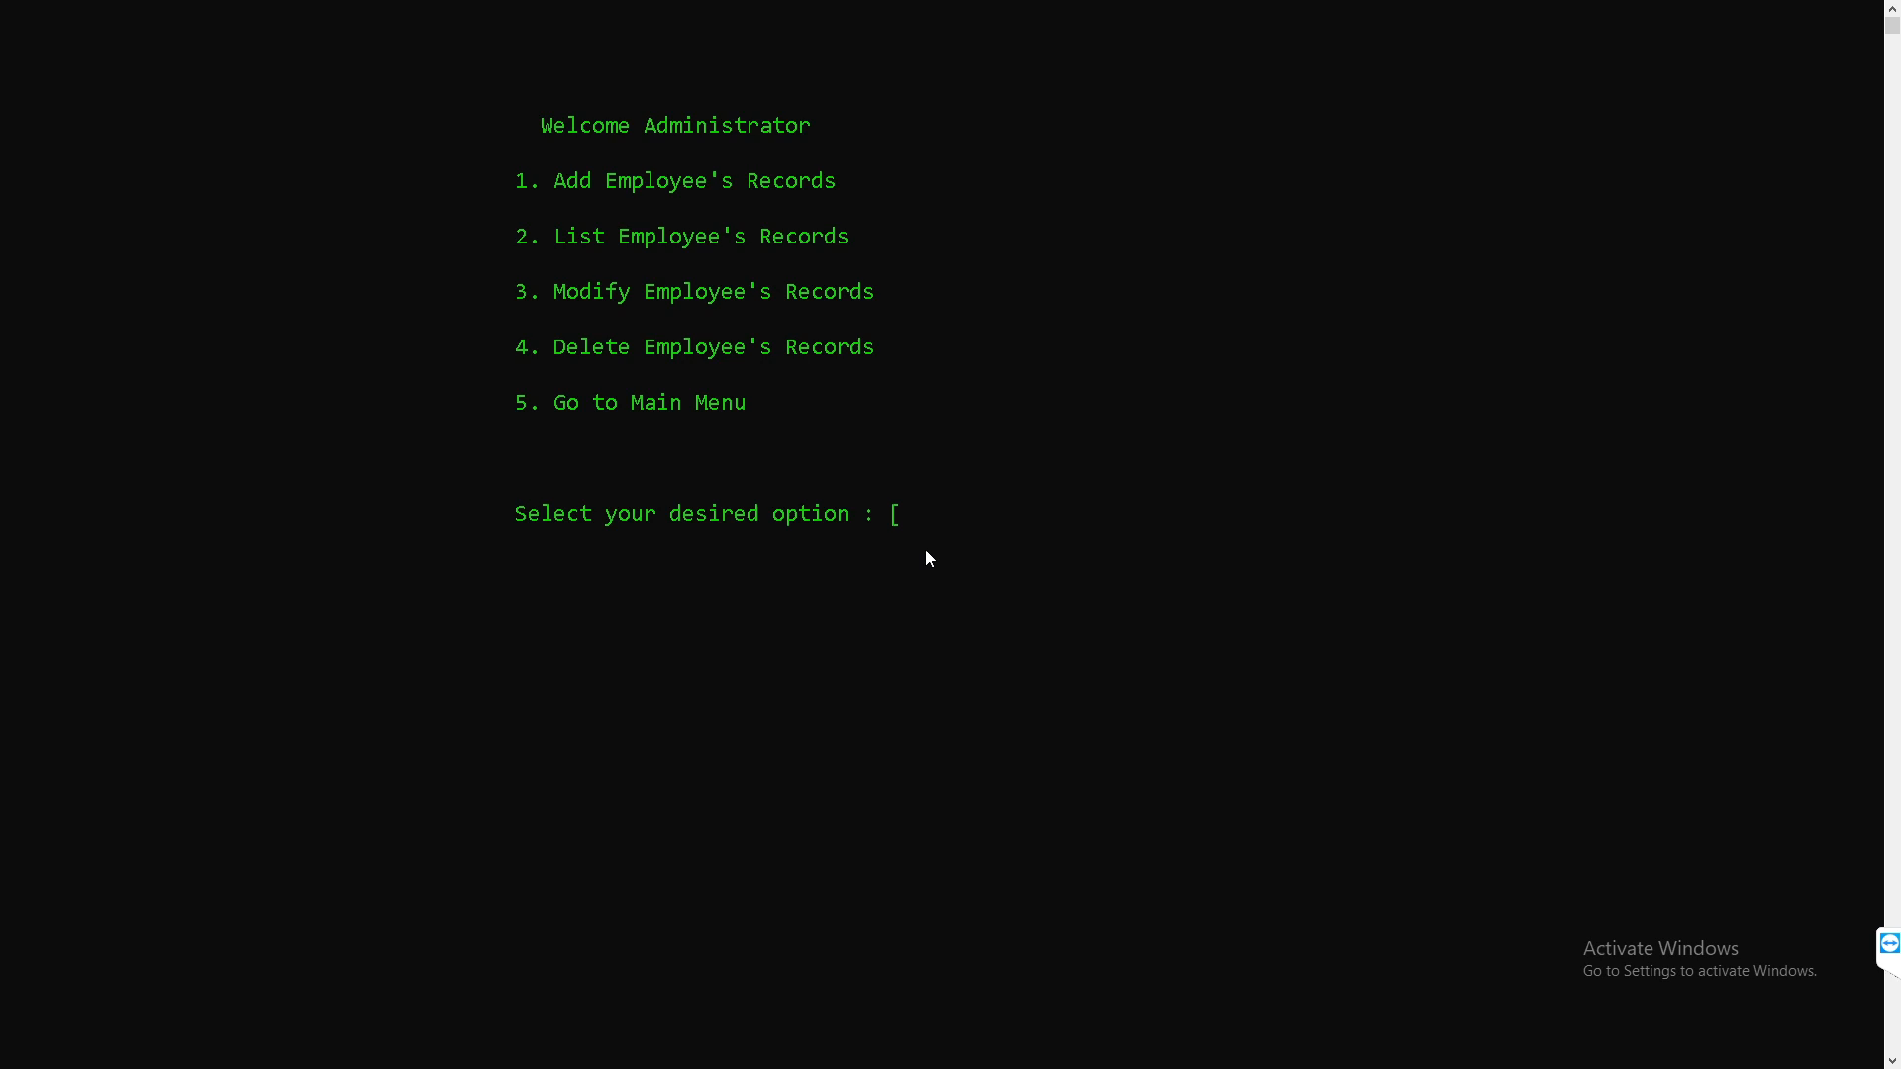
List employees record

Slide 12
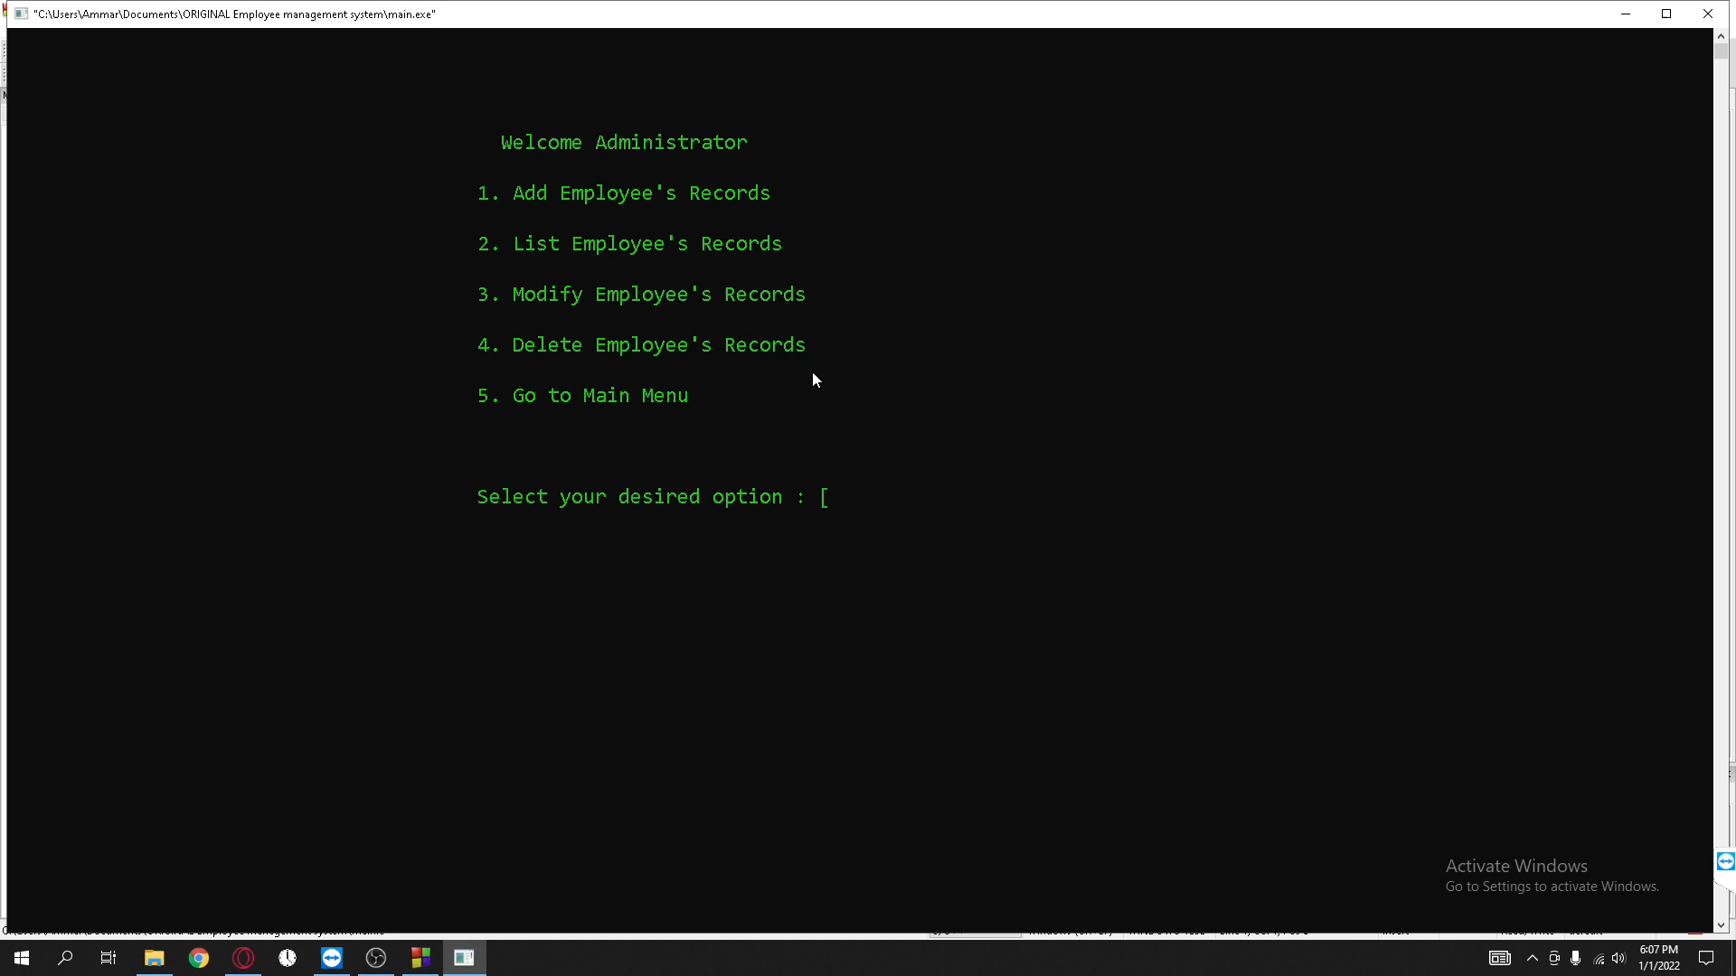
Modify or update employee record

Slide 13

Delete employee record

Slide 14

Go to main menu

Slide 15

Employee detail + exit

Slide 16
THANKS!

